Slide 1
Personal Social Services Adult Social Care Survey, England 2014-24
The impact of social care services and profile of service users
6th February 2025

Slide 2
About the survey
The survey explores the impact of long-term support services funded or managed by social services. This includes:
  How effectively these services are helping service users to live safely and independently in their own homes.
  How the services impact on service users’ quality of life.
The survey is administered annually by individual local authorities to a random sample of eligible service users (aged 18 and over) and collated by NHS Digital.
Today we are looking back at the last 10 years of responses. There was a different methodology pre-2014.
Notes:
Some local authorities have changed over the period so this skews some rankings slightly.
2020/21 response rates were typically 10% of typical previous years.

Slide 3




The context in 2014-15…
“Whatever happens much austerity lies ahead”
Notes:
A lot of things have changed in the world, and we’d maybe expect a lot to change in social care too… we’d probably predict not for the better.
5 years of Lib Dem / Conservative coalition government.
2015 general election won surprisingly by Conservatives. Jeremy Corbyn new labour leader,
Had had five years of austerity and cuts to LA’s with no real sign of this stopping. This was less about policy per se than about money and trying to balance things out.
However, things still broadly worked as they should – including social care. Many of the unexpected shifts of the next few years were not yet reality. We were still in the EU, Trump’s candidacy was just a seedling. Changes like new geopolitical conflicts, a more polarised form of politics at home and abroad COVID-19 were all to come and not all predicted.
PPT source: https://ifs.org.uk/sites/default/files/output_url_files/budget2014_bbc.pdf

Slide 4
Profile of respondents
Response rates vary greatly across questions - but generally in tens of thousands (e.g. 58,000 responses for overall satisfaction with services, in 2023-24).
Usually, most respondents (73-80%) have help in doing the survey.
Respondents are likely a mix of older people and people with a learning disability.
2020-21 had low response rate (only 18 LA’s) due to COVID-19 – take with a pinch of salt.
Kirklees, Wakefield, York, Liverpool, Norfolk, Oxfordshire, West Berkshire, Reading, Windsor and Maidenhead, Southend-on-Sea, Barking and Dagenham, Bexley, Enfield, Hillingdon, Hounslow, Isle of Wight, Torbay, Buckinghamshire
Notes:
We know from research with people with a learning disability // older people who are helped to participate, that this can bump up scores positively.

Slide 5
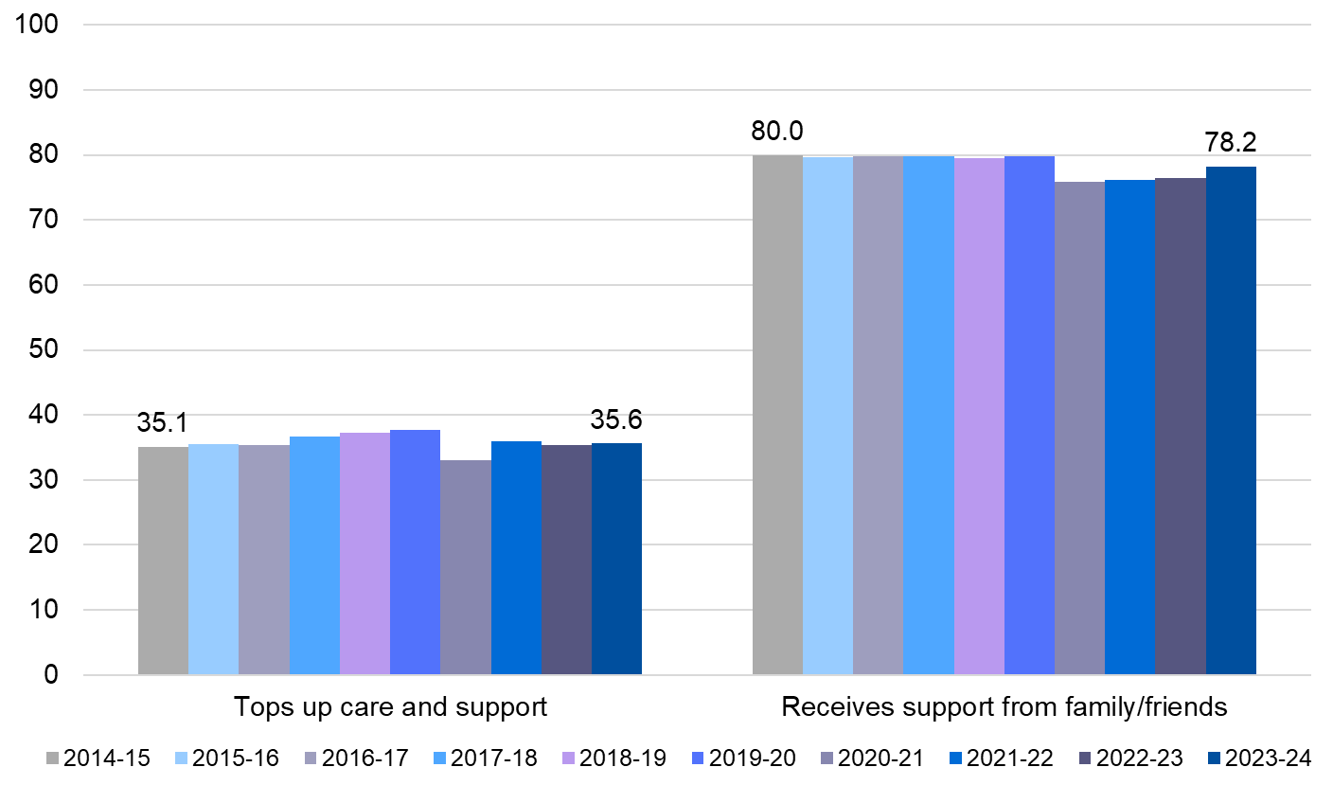
Profile of respondents
Around a third of respondents top up their care and support.
Most respondents – four fifths - receive support from family and friends
Notes:
SO when we look at satisfaction, for better or worse, its not all about you guys!

Slide 6
Overall satisfaction with care and support services received

Slide 7
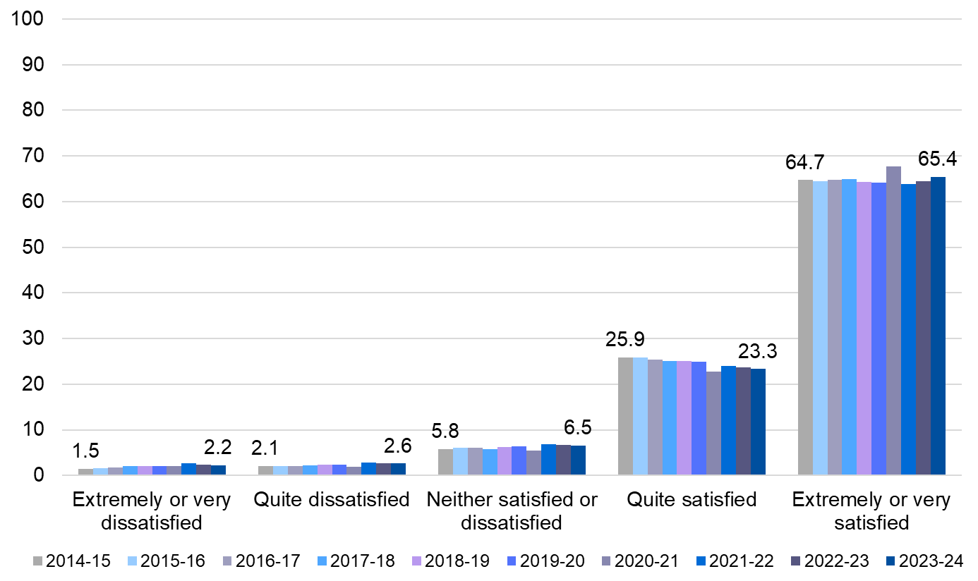
Overall satisfaction with care and support services
Most people – around 90% - remain satisfied with services.
The majority are extremely or very satisfied.
There has been some increase in dissatisfied service users in the last 10 years.
Slightly better
Worse
Slightly worse
Slightly worse
Slight increase
Notes:
As a starting point, these are great results for most public services – much better than NHS.
But there is a gradual polarisation (albeit small) towards extremely satisfied vs. not satisfied or worse.

Slide 8
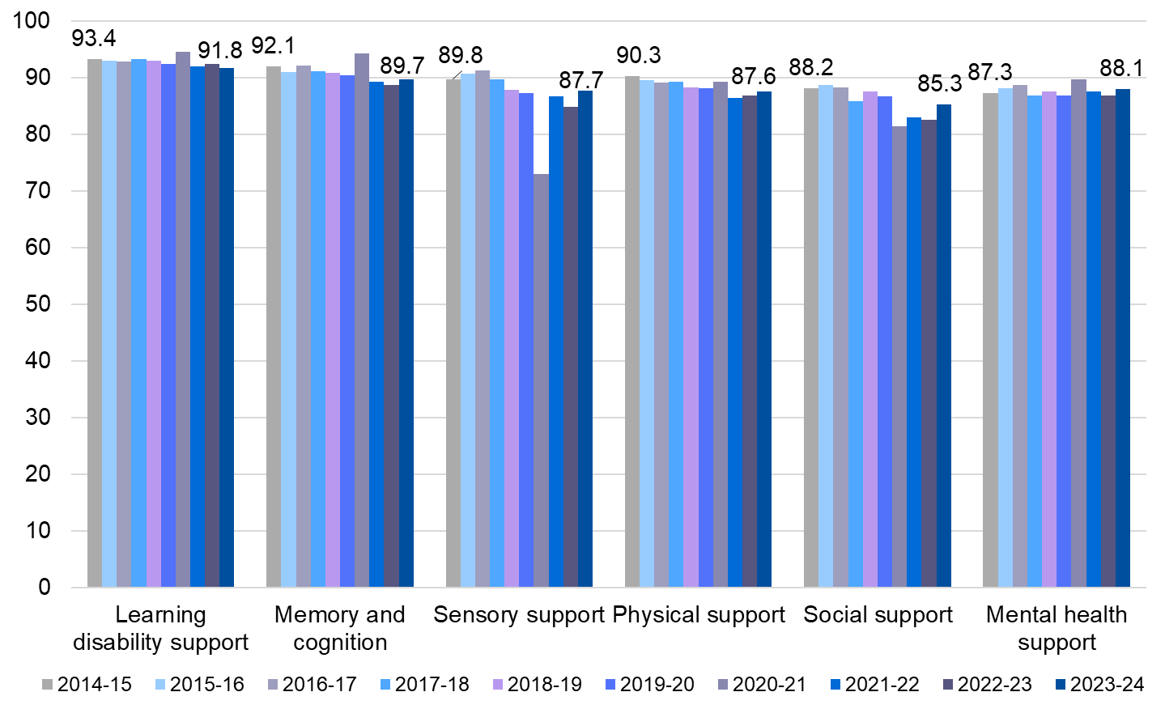
Satisfaction by main support reason
Slightly worse
Slightly worse
Slightly worse
Slightly worse
Slightly worse
Slight improvement
Satisfaction remains higher amongst those with a learning disability than other groups.
Most groups experienced an overall downward trend in satisfaction until COVID-19, followed by some patchy recovery.
People supported for their mental health have become slightly more satisfied over time, but with lots of fluctuation.
Notes:
Quite + extremely (dis)satisfied combined
Broken down by ‘reason for support’, satisfaction has steadily declined since 2014 for most groups. Others have been more up-and-down: social support and physical support (overall down) and mental health support (overall up).
On the whole, satisfaction between 2014 and 2024 (direct comparison of those years) main support reasons have declined, with the exception of mental health support which has a higher satisfaction rate in 2024 (88.2) than 2014 (87.3), albeit marginal

Slide 9
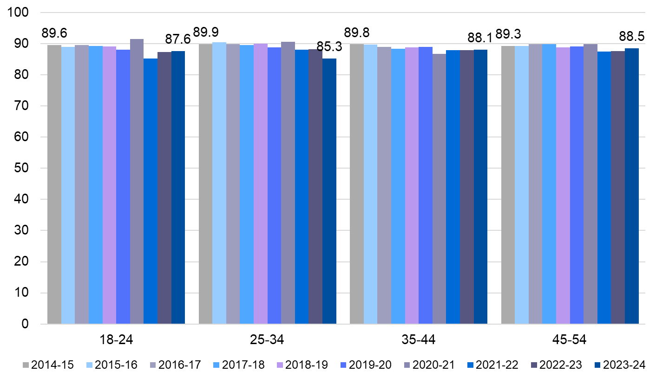
Satisfaction levels by age (1 of 2)
Slightly worse
Slightly worse
Slightly worse
Slightly worse

Slide 10
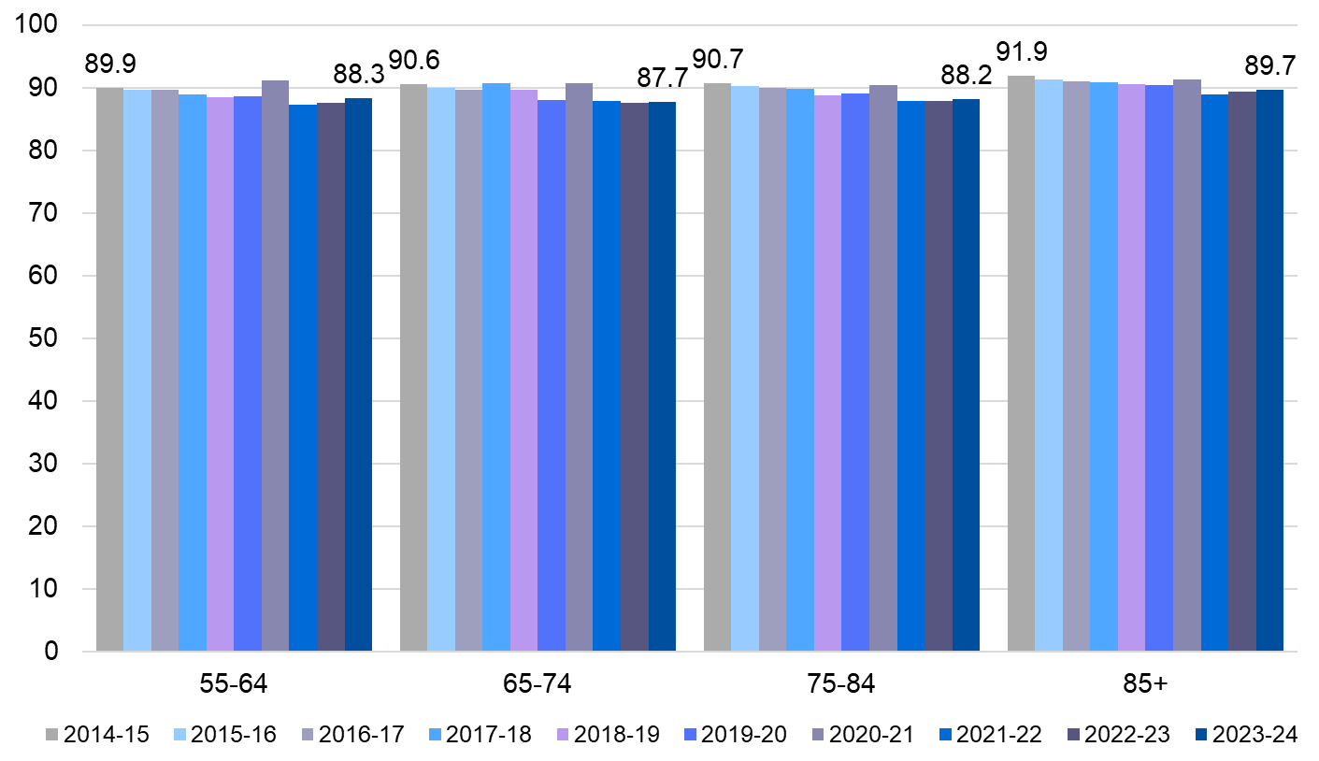
Satisfaction levels by age (2 of 2)
Slightly worse
Slightly worse
Slightly worse
Slightly worse
Pre-COVID, satisfaction was fluctuating for most age groups, but there was a clearer downward trend for over-55s.
Post-COVID, satisfaction has been steadying and slowing increasing for most age groups, except for 25-34-year-olds, whose satisfaction is lowering. For 25-34-year-olds, satisfaction is at its lowest point in 10 years.
Notes:
> 25-34 & 65-74 – change in services

Slide 11
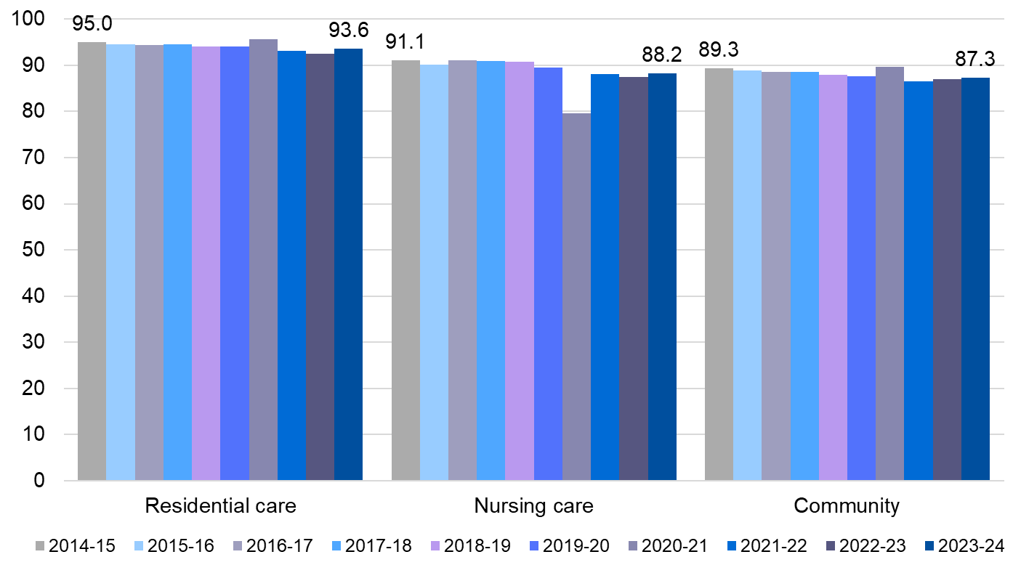
Satisfaction by care setting
Slightly worse
Slightly worse
Slightly worse
Satisfaction remains highest in residential care settings, followed by nursing and then community care (which are closer together).
However, residential and community care have seen more consistent downward trends than nursing care.
Community care has seen the only consistent upward trend since the pandemic.

Slide 12
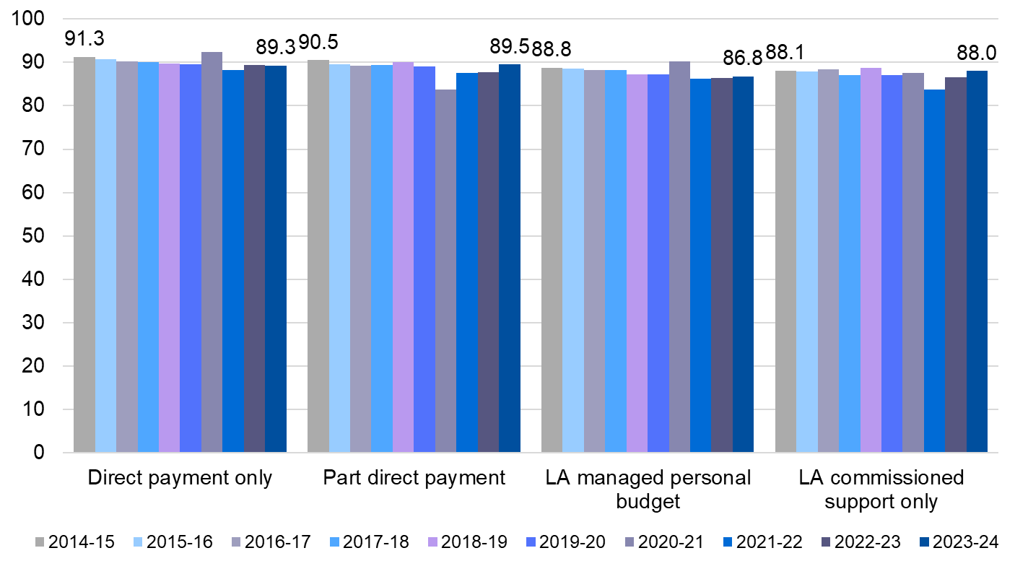
Satisfaction levels by mechanism of payment
Slightly worse
Slightly worse
Slightly worse
Slightly worse
Those who pay – fully or partly – have higher satisfaction in general. Their satisfaction was decreasing but in recent years has started to recover a little.
Over the past 10 years, ‘LA managed personal budget’ has swapped with ‘LA commissioned support only’, and satisfaction with ‘LA managed personal budget’ is now slightly lower.
Notes:
By payment method, the overall downward trend in satisfaction is less strong for those with ‘LA commissioned support only’, whose satisfaction has been increasing since COVID-19.
There have been upward trends post-COVID, of varying levels.
Seems to be a clear shift towards dissatisfaction with self-managed or direct payment budgets until the pandemic, after which, satisfaction with these payment methods have been increasing.

Slide 13
Overall satisfaction remains high in all areas
… but is uniformly getting worse over time.
The good news is that there are signs of recovery, post-Covid-19 and that satisfaction is maybe better than we would have predicted given the direction of travel in 2014-15.
The next few questions look at what areas of care practice work best, and where the sector might do better.
Notes:
We have grouped the survey finding against themes that relate to the co-produced ‘making it real’ statements - a set of co-produced statements that describe what good care and support looks like. They are aligned to the Care Act, and built in to the CQC Single Assessment Framework.

Slide 14
‘Making it Real’ statements for wellbeing and independence
Some aspects are not well-captured by the survey.
Co-produced statements for what good care and support looks like. Aligned to the Care Act, built into CQC Single Assessment Framework.
  I can live the life I want and do the things that are important to me as independently as possible.
  I am treated with respect and dignity.
  I feel safe and am supported to understand and manage any risks.
  I am supported to manage my health in a way that makes sense to me.
  I have people in my life who care about me – family, friends and people in my community.
  I am valued for the contribution that I make to my community.
  I have a place I can call home, not just a ‘bed’ or somewhere that provides me with care.
  I live in a home which is accessible and designed so that I can be as independent as possible.
‘Choice about support’ was added in 2016, and ‘loneliness’ in 2022. Questions on people’s experiences (e.g. quality of life) are nuanced. However, the helpfulness of services are YES/NO.

Slide 15
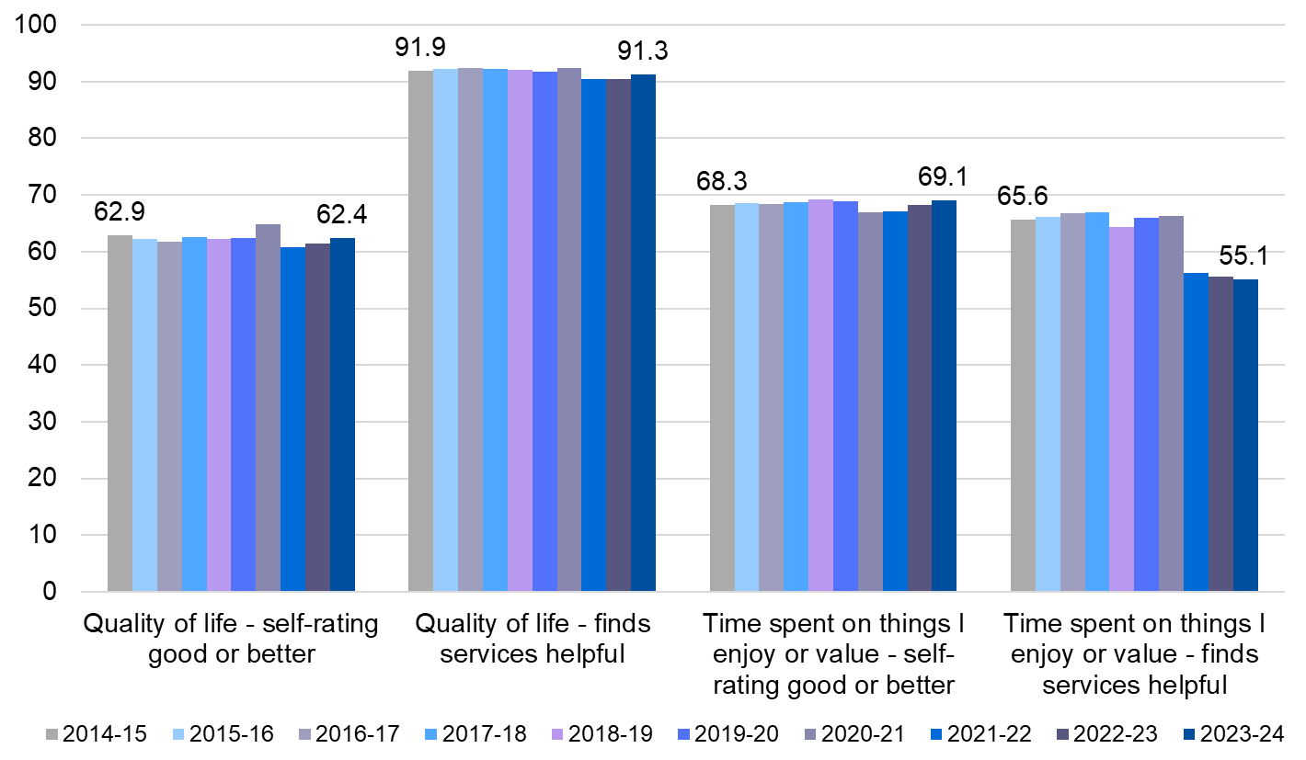
Choice and independence (1 of 2)
Slightly worse
Slightly better
Worse
Slightly worse
Two thirds of people are fairly happy with quality of life and how they spend their time – so experiences are mixed.
Most people find that services help with their quality of life. There is less satisfaction with the way services support people to spend their time. This dipped post-COVID and has not recovered.
Notes:
I can live the life I want and do the things that are important to me as independently as possible.
- Can understand why services have dropped post-COVID, it suggests that perhaps some day services haven’t returned? But this component of care is much more absent

Slide 16
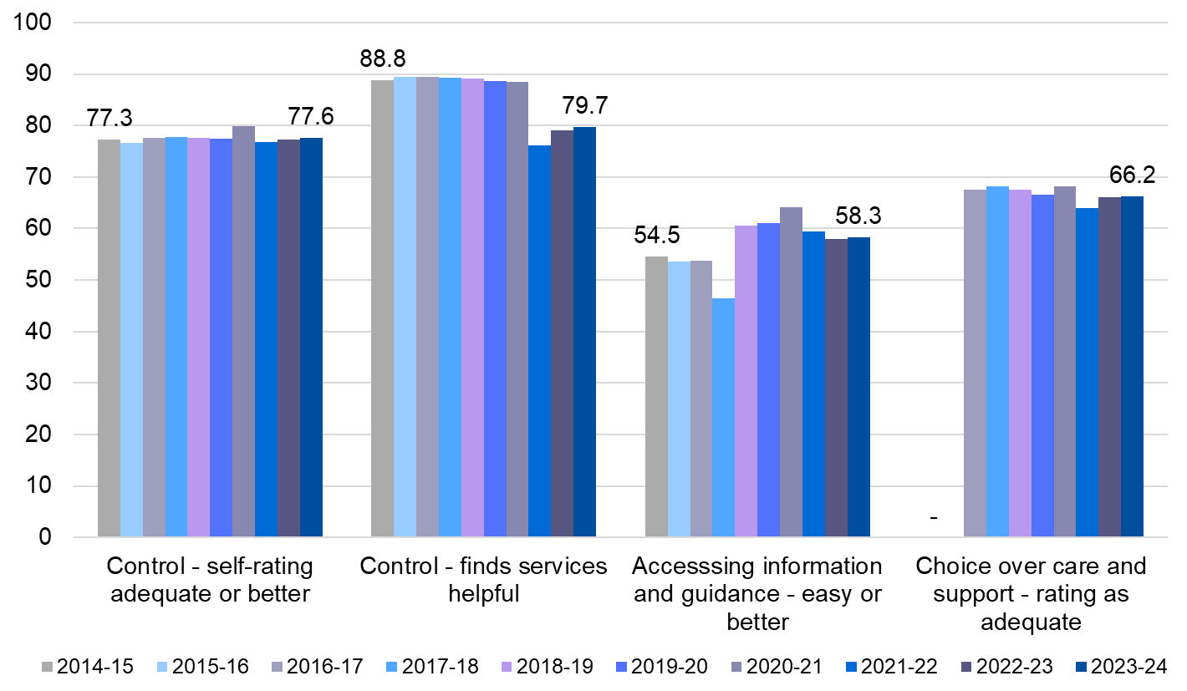
Choice and independence (2 of 2)
Worse
Slightly better
Slightly worse
Slightly better
People’s rating of the control they have is positive, but the role of services dipped after COVID-19. It has been improving since then.
More people find it easy to access information and guidance than 10 years ago, but this is worse than other areas.
Only two thirds of people feel they have enough choice over their support.
Notes:
I can live the life I want and do the things that are important to me as independently as possible.

Slide 17
Performance against best practice
Choice and independence: overall satisfaction with quality of life is good, but room for improvement around information and meaningful activities.

Slide 18
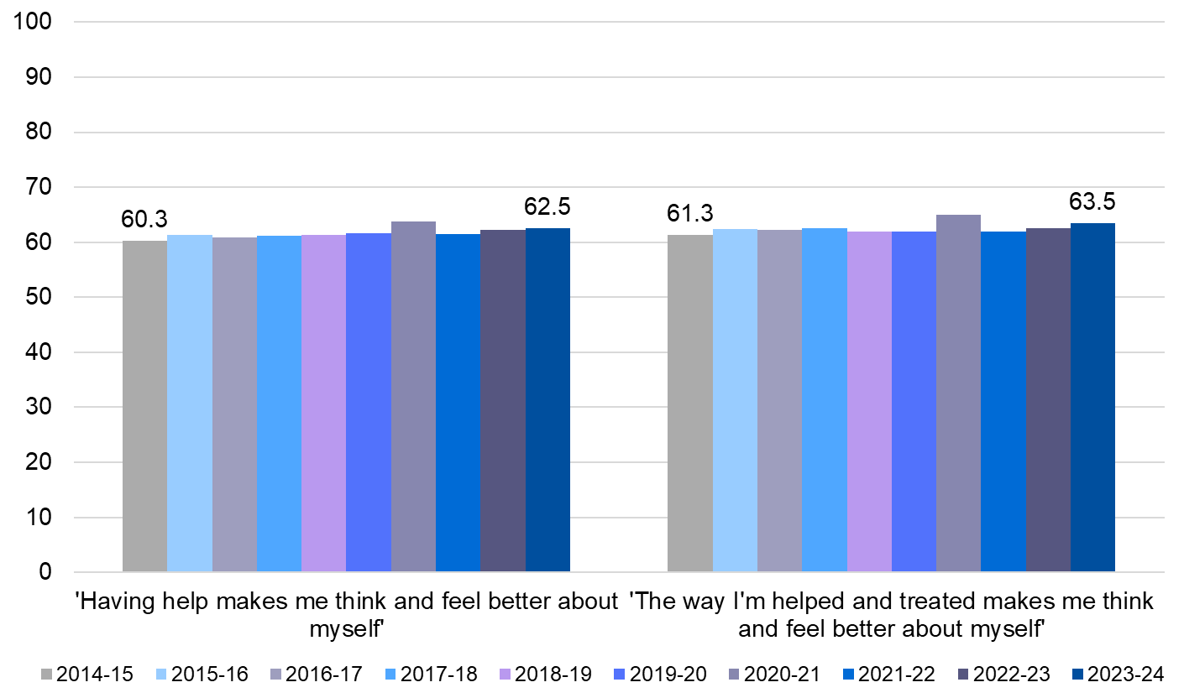
Self-image and receiving support
Slightly better
Slightly better
Overall, people’s experiences are positive and making moderate improvements.
But there is room for a more nuanced understanding of respect and dignity.
Notes:
I am treated with respect and dignity.

Slide 19
Performance against best practice
Choice and independence: overall satisfaction with quality of life is good, but room for improvement around information and meaningful activities.
Respect and dignity: still room for improvement, but steady improvements in how people feel about themselves and how people are helped.

Slide 20
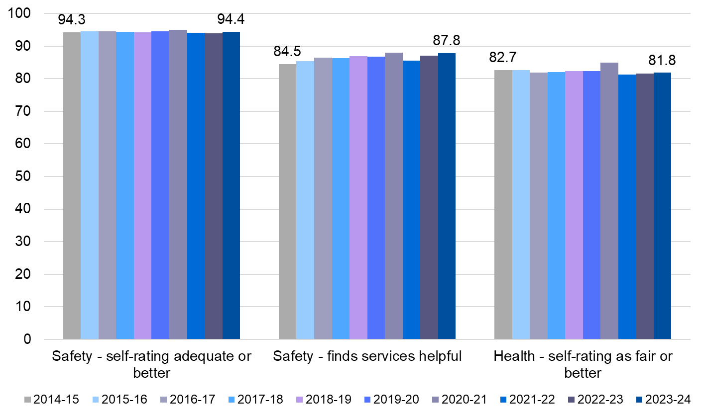
Safety and health
Slightly better
Slightly better
Slightly worse
People experiences of safety, and the way services help with this, are positive steadily improving.
Health is rated as ‘fair’ or better by most people – but over the years this has become a more polarised, with fewer people rating their health as middling and more people at either extreme end.
The survey does not explore the role of services in people understanding and managing risks to their health or safety.
Notes:
I feel safe and am supported to understand and manage any risks.
I am supported to manage my health in a way that makes sense to me.

Slide 21
Performance against best practice
Choice and independence: overall satisfaction with quality of life is good, but room for improvement around information and meaningful activities.
Respect and dignity: still room for improvement, but steady improvements in how people feel about themselves and how people are helped.
Managing risks and health: self-rated health hasn’t got better, but we’re doing a good job helping to keep people safe.
Notes:
And this is what social care has traditionally been best at – safety first; the question is can we co beyond safety first towards promoting positive risk-taking behaviours and independence.,

Slide 22
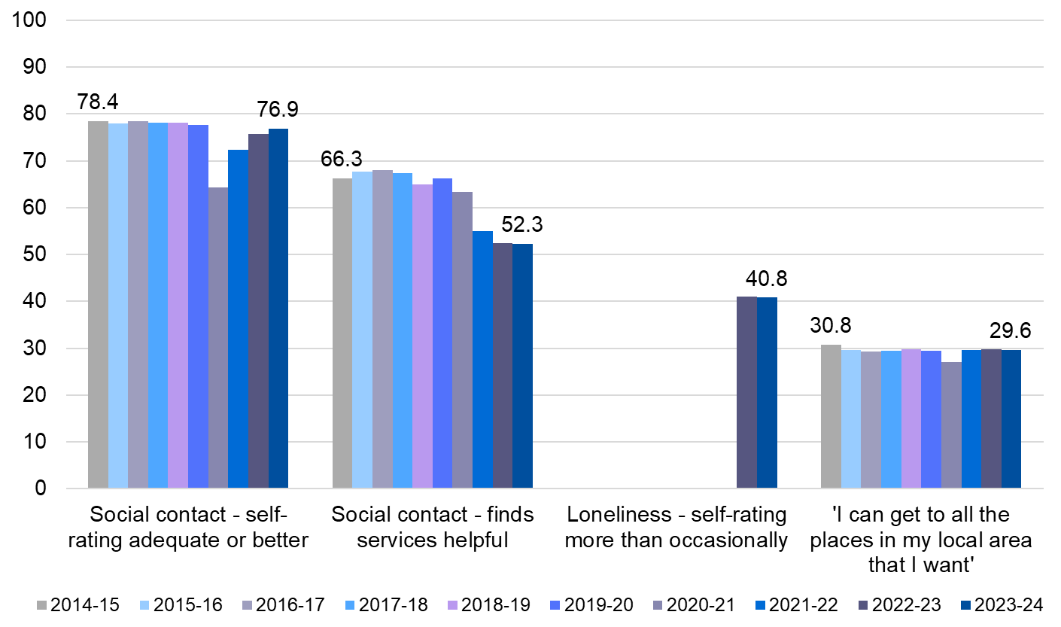
Social connection, belonging and community
Social contact was slowly declining and then took a bigger hit COVID-19, taking years to recover. The role of services remains poor, and roughly half of respondents do not find services helpful. Most people do not experience adequate access to local areas
Loneliness affects 40% of respondents.
Slightly worse
Slightly worse
Slightly worse
Slightly worse
Notes:
I have people in my life who care about me – family, friends and people in my community.

Slide 23
Performance against best practice
Choice and independence: overall satisfaction with quality of life is good, but room for improvement around information and meaningful activities.
Respect and dignity: still room for improvement, but steady improvements in how people feel about themselves and how people are helped.
Managing risks and health: self-rated health hasn’t got better, but we’re doing a good job helping to keep people safe.
Contribution to community: Even though these topics have been high profile, there is more room for improvement in terms of social isolation and connections, than in some other areas of support.

Slide 24
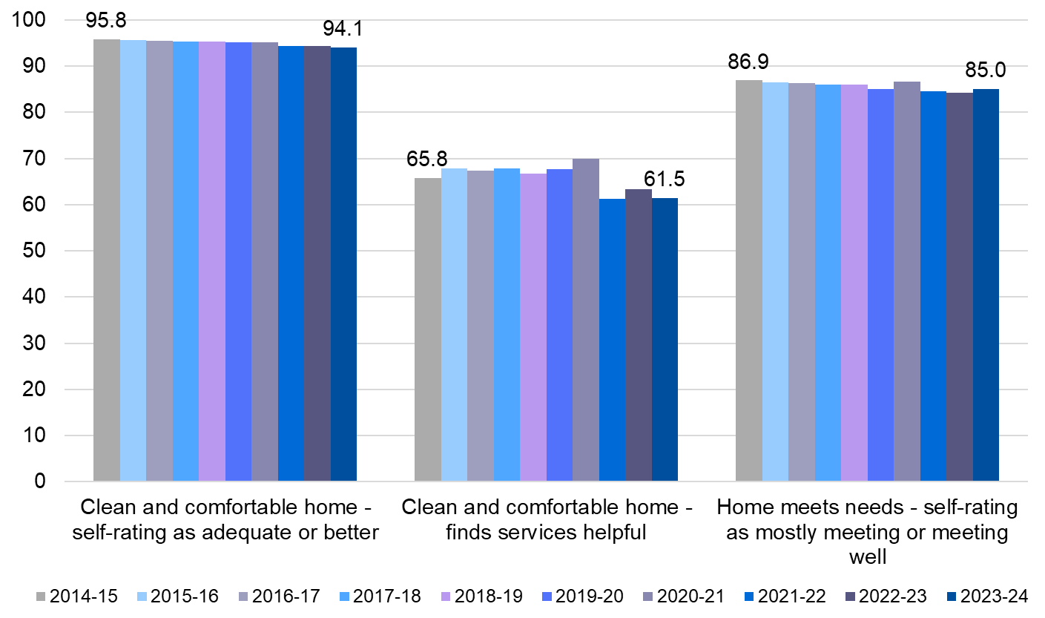
Home and accessibility
Slightly worse
Slightly worse
Slightly worse
Almost all respondents are satisfied with how clean and comfortable their home is, but the helpfulness of services with this is less strong and has decreased over time.
Accessibility is overall positive but has slightly declined year on year.
Feeling at home is not measured.
Notes:
I have a place I can call home, not just a ‘bed’ or somewhere that provides me with care.
I live in a home which is accessible and designed so that I can be as independent as possible.

Slide 25
Performance against best practice
Choice and independence: overall satisfaction with quality of life is good, but room for improvement around information and meaningful activities.
Respect and dignity: still room for improvement, but steady improvements in how people feel about themselves and how people are helped.
Managing risks and health: self-rated health hasn’t got better, but we’re doing a good job helping to keep people safe.
Contribution to community: Even though these topics have been high profile, there is more room for improvement in terms of social isolation and connections, than in some other areas of support.
A place that I can call home: broadly people like their homes, but are less satisfied with the services they receive to maintain them.

Slide 26
Results by local authority
Notes:
Satisfaction by LA excludes tables exclude ‘neither satisfied nor dissatisfied’ (so satisfied + dissatisfied =/= 100%)

Slide 27
Top local authorities for service user satisfaction over the past 10 years**
Local authority | Frequency | 14-15 | 15-16 | 16-17 | 17-18 | 18-19 | 19-20 | 21-22 | 22-23 | 23-24
Rutland | 6 |  |  | ✓ | ✓ | ✓ | ✓ |  | ✓ | ✓
Barnsley | 5 |  | ✓ |  |  | ✓ |  | ✓ | ✓ | ✓
East Riding of Yorkshire | 4 |  | ✓ | ✓ |  |  |  |  | ✓ | ✓
Blackburn with Darwen | 4 | ✓ | ✓ | ✓ |  |  | ✓
Middlesborough | 3 |  |  |  | ✓ | ✓ |  | ✓
Derbyshire | 3 |  |  | ✓ |  | ✓ |  |  | ✓
Warwickshire | 3 |  |  |  | ✓ | ✓ |  |  | ✓
Isle of Wight | 3 | ✓ | ✓ | ✓
If you’re doing well, you don’t necessarily stay there. Most LAs in the ‘top 10’ were there for 3 of the last 10 years.
* Not including 2020-21 ** LAs which have appeared three times or more
Notes:
Shows that if you’re doing well, you don’t necessarily stay there year on year. Most people were in top 10 for 3 years…
Many Northern areas with high satisfaction
Rutland has appeared in the top 10, six out of nine times in the last 10 years.
The only LA to spend four consecutive years in the top 10, and has spent 3 years at the top spot #1 for service user satisfaction including the last two consecutive years (2017-18, 2022-23, 2023-24)

Slide 28
Top 10 LA’s for satisfaction: 2014 vs 2024
2014 | % satisfied customers | 2024 | % satisfied customers
East Riding of Yorkshire | 95.3% | Rutland | 96.3%
Sefton | 95.0% | City of London | 96.2%
Isle of Wight | 94.8% | Warwickshire | 95.2%
Blackburn with Darwen | 94.6% | Reading | 93.5%
Lancashire | 94.4% | West Berkshire | 93.3%
Poole | 94.3% | South Gloucestershire | 93.2%
Bournemouth | 94.0% | Hartlepool | 93.1%
North Somerset | 94.0% | East Riding of Yorkshire | 92.6%
West Sussex | 93.9% | Barnsley | 92.5%
Medway Towns | 93.8% | Cumberland | 92.3%
Notes:
East Riding of Yorkshire was in the top 10 both years.
Reading was in the top 10 in 2024 but has also been in the top 10 LA’s for dissatisfaction in the past 10 years.

Slide 29
Top local authorities for service user dissatisfaction over the past 10 years**
Local authority | Frequency | 14-15 | 15-16 | 16-17 | 17-18 | 18-19 | 19-20 | 21-22 | 22-23 | 23-24
Waltham Forest | 7 | ✓ | ✓ | ✓ |  | ✓ | ✓ | ✓ | ✓
Lambeth | 6 | ✓ | ✓ | ✓ | ✓ | ✓ |  |  | ✓
Hammersmith and Fulham | 5 | ✓ |  |  | ✓ | ✓ | ✓ |  |  | ✓
Sheffield | 5 | ✓ | ✓ | ✓ |  |  | ✓ | ✓
Manchester | 5 | ✓ | ✓ |  |  | ✓ |  | ✓ | ✓
Ealing | 4 | ✓ |  |  |  |  | ✓ | ✓ |  | ✓
Southwark | 4 |  | ✓ |  | ✓ | ✓ |  |  |  | ✓
Islington | 3 | ✓ | ✓ |  | ✓
Brent | 3 | ✓ | ✓ |  |  | ✓
Kensington and Chelsea | 3 |  |  | ✓ | ✓ | ✓
Hillingdon | 3 |  | ✓ |  |  |  | ✓ | ✓
By comparison, if you’re doing poorly, you might stay in that position for longer. The LAs who were often in the ‘bottom 10’ were there more often than those in the ‘top 10’.
* Not including 2020-21 ** LAs which have appeared three times or more
Notes:
However, if you’re down, it tends to take a longer time to get out of that – most commonly people were here for 5 years.
Many London local authorities experience lower satisfaction.
Waltham Forest has appeared in the top 10 for service user dissatisfaction 7 out of 9 times in the last 10 years
Kensington and Chelsea spent three consecutive years in the top 10 (top 3) for service user dissatisfaction, two of which they were ranked the top LA for unhappy customers (2016-17, 2017-18)

Slide 30
Top 10 for dissatisfaction: 2014 vs 2024
2014 | % dissatisfied customers | 2024 | % dissatisfied customers
Islington | 8.6% | Hammersmith and Fulham | 12.5%
Hammersmith and Fulham | 7.5% | Merton | 11.8%
Lambeth | 7.5% | Southwark | 11.2%
Sheffield | 7.4% | Luton | 10.7%
Ealing | 7.3% | Trafford | 10.5%
Hounslow | 7.2% | Ealing | 10.5%
Manchester | 7.1% | Greenwich | 10.1%
Waltham Forest | 6.9% | Kingston upon Thames | 8.8%
Brent | 6.5% | Tower Hamlets | 8.7%
Buckinghamshire | 6.4% | Halton | 8.6%
The most dissatisfied places are more dissatisfied now than in 2014 i.e. where things were bad before, they are worse today.
Notes:
Both Ealing and Hammersmith and Fulham were in the top 10 for service user dissatisfaction in both 2014 and 2024
In both cases, the percentage of dissatisfied customers has increased compared to 10 years ago

Slide 31
10 highest rates of funding top-ups or private care purchased – 2014 v 2024
2014-15 | Percentage | 2023-24 | Percentage
Telford and Wrekin | 44.5% | St Helens | 48.8%
Dorset | 43.5% | Harrow | 46.4%
Newcastle upon Tyne | 42.4% | Cumberland | 45.3%
East Riding of Yorkshire | 42.1% | Bolton | 44.7%
Camden | 42% | Westmorland and Furness | 43.9%
Hammersmith and Fulham | 41.8% | Stockport | 43.9%
York | 41.8% | Trafford | 42.9%
North Tyneside | 41.7% | Leicestershire | 42.8%
Middlesbrough | 41.6% | Croydon | 42.8%
Leicestershire | 41.3% | North Tyneside | 42.6%
The rates of people purchasing or topping up have risen in the past 10 years – in some areas close to half of respondents.
A key question for the future is, ‘Who is going to pay for social care?’ This data indicates that increasingly, service users are. This is likely to be amongst older people.
Notes:
Interesting to see trend on top-ups, got KC review now asking future of social care, needs to answer who's going to pay for it? Not LD bc no jobs, but older people - increasingly older people themselves, bc not satisfied or have to.
The highest rates are getting higher – closer to 50% than 40%...
Leicestershire has been in the top 10 highest private funders 4x in past 10 years
Stockport – 6x in last 10 years (years)
Scatter of top-ups vs. satisfaction? If top-up, is there more of a view of people as clients? And therefore more focus on keeping people happy?

Slide 32
10 lowest rates of funding top-ups or private care purchased – 2014 v 2024
2014-15 | Percentage | 2023-24 | Percentage
Shropshire | 21.6% | Tower Hamlets | 25.2%
Greenwich | 24.4% | Sunderland | 26.5%
Kensington and Chelsea | 25% | Blackpool | 26.8%
Cambridgeshire | 25.2% | Westminster | 27.1%
Derbyshire | 25.2% | Rochdale | 27.3%
Cheshire East | 26.8% | East Riding of Yorkshire | 27.4%
Bedford | 27.6% | Nottingham | 27.4%
Sunderland | 28% | Manchester | 28.1%
Wirral | 28.2% | Warwickshire | 28.1%
Sutton | 28.5% | Camden | 28.6%
The lowest rates of purchasing or topping-up are also getting higher – closer to a quarter of respondents than a fifth, in the LA’s where this is lowest.
There is more consistency year-on-year in these LA’s, compared to the LA’s with highest top-up rates. E.g., Tower Hamlets x7 in 10 years, Hammersmith & Fullan x5 in 10 years.
Notes:
…And the lowest rates are getting higher, closer to a quarter than a fifth. Overall, more people are topping up care or purchasing private care.
Tower Hamlets has been in the top 10 of lowest private funders for 7x in the last 10 years
Hammersmith and Fulham – 5x in last 10 years, in 2014, H&F were in the top 10 for highest private funders

Slide 33
Conclusions
Overall, most people are happy with the care and support they receive. This is an impressive feat given the way 2014-2024 has been.
Most people are doing a good job - but some aspects are less strong:
  Social connection, belonging and community
  Supporting people to have control and access to information and guidance
  Supporting people to access their local area and spend time in ways they value
Some local areas are performing slightly better than others
  Its hard to maintain top levels of performance, but easier to get stuck towards the bottom.
The way we appraise social care for adults has been changing
  The data is not always measuring ‘what good looks like’, so it’s important to remain inquisitive on these
Notes:
Overall positive high satisfaction, given the unprecedented challenges of the past 10 years.

